Slide 1
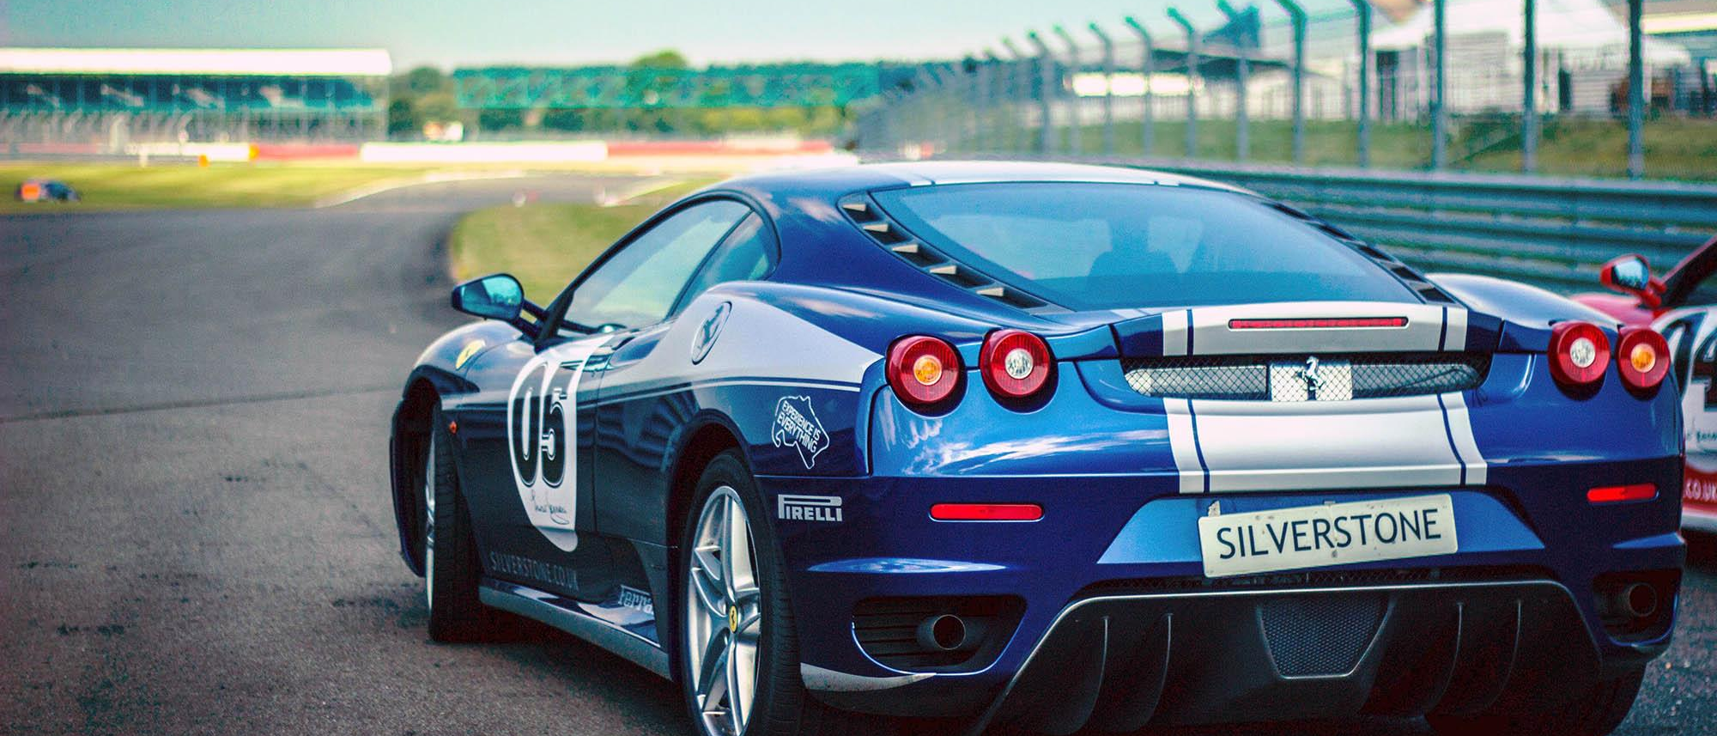




License Plate Detection System
Developed By –
Pranav Dange

Slide 2

Introduction
Work flow
Data Collection
Models/ Tools used
Custom Training
Deployment
Summary
References
Agenda

Slide 3
Problem Statement
I intend to detect the License Plate of any vehicle – though be in Car, Bus, Truck from images or Video.
Once developed can be used in multivariate applications like Traffic monitoring, criminal activity identification, etc.
Dataset link –
https://storage.googleapis.com/openimages/web/visualizer/index.html?set=train&type=detection&c=%2Fm%2F01jfm_
Drive Link for Trained Model –
https://drive.google.com/drive/folders/1Diy9gLYAlwk4q3XR5YUVp-xW88Tgurhb?usp=sharing

Slide 4
Workflow
1
2
3
4
Custom Training on Google Collab for our class
Detection on Test Images
Data Collection and Annotation
Cloning Darknet Model and setting State of Art Model
Final Model Ready :
Using final weights, obj.names, configuration files for Deployment on Flask locally
Solving dependencies and simple Input – Output UI

Slide 5
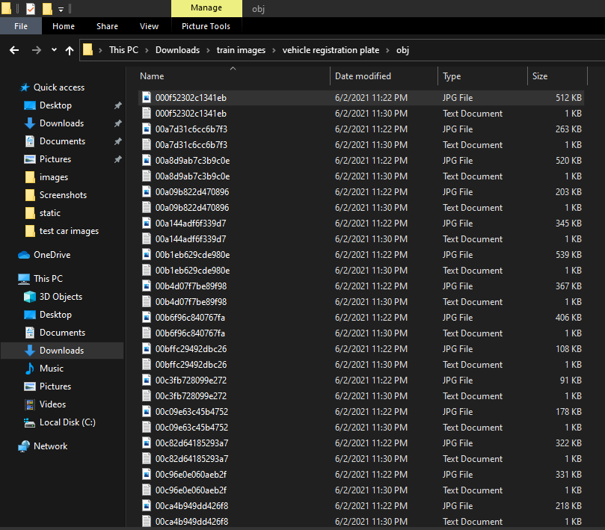
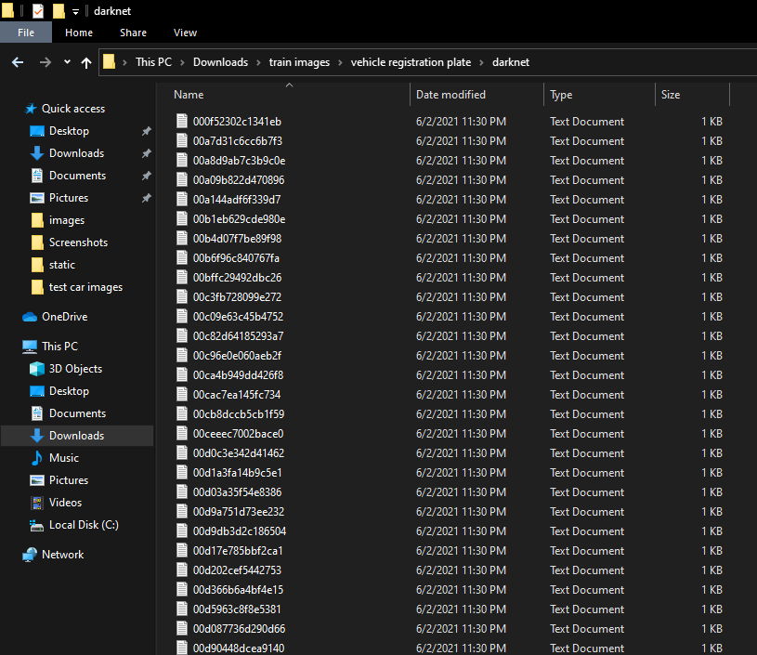

.txt files for every image on Training image
Images
The size of the dataset used for training is 5656 + images + the validation dataset and different Test Dataset
In order to create a custom object detector we need a good dataset of images and labels so that the detector can be efficiently trained to detect objects.
This can be done in two ways.
- Through or through using Google images
- Creating your own dataset and using an annotation tool to manually draw labels.

Slide 6


Custom Training
This step involves properly configuring your custom .cfg, obj.data, obj.names, train.txt and test.txt files.
It is important to configure all these files with extreme caution as typos or small errors can cause major problems with your custom training
Configuring Variables:
width = 416
height = 416 (these can be any multiple of 32, 416 is standard, we can sometimes improve results by making value larger like 608 but will slow down training)
max_batches = (# of classes) * 2000 (but no less than 6000 so if you are training for 1, 2, or 3 classes it will be 6000
steps = (80% of max_batches), (90% of max_batches) (so if your max_batches = 10000, then steps = 8000, 9000)
filters = (# of classes + 5) * 3 (so if you are training for one class then your filters = 18
The last configuration files needed before we can begin to train our custom detector are the train.txt and test.txt files which hold the relative paths to all our training images and validation images.

Slide 7

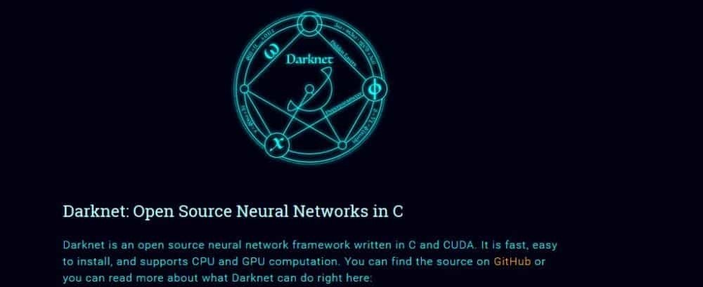

Darknet and TensorFlow

Slide 8

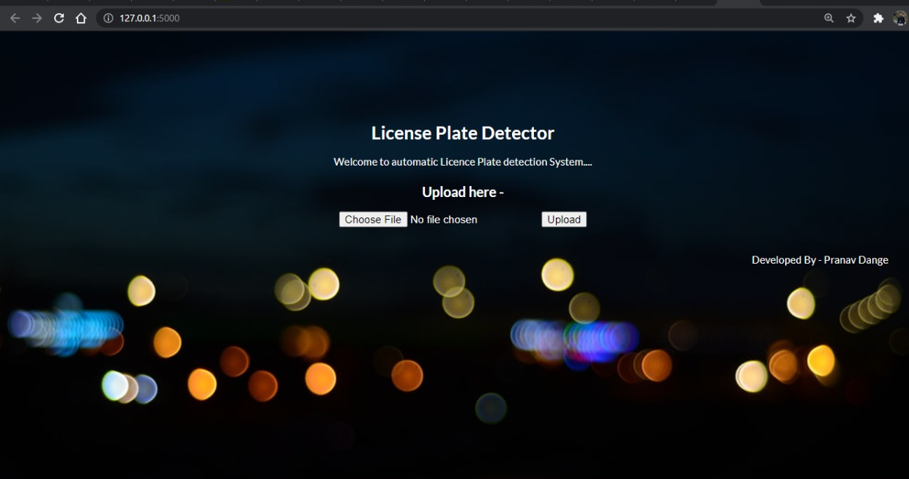
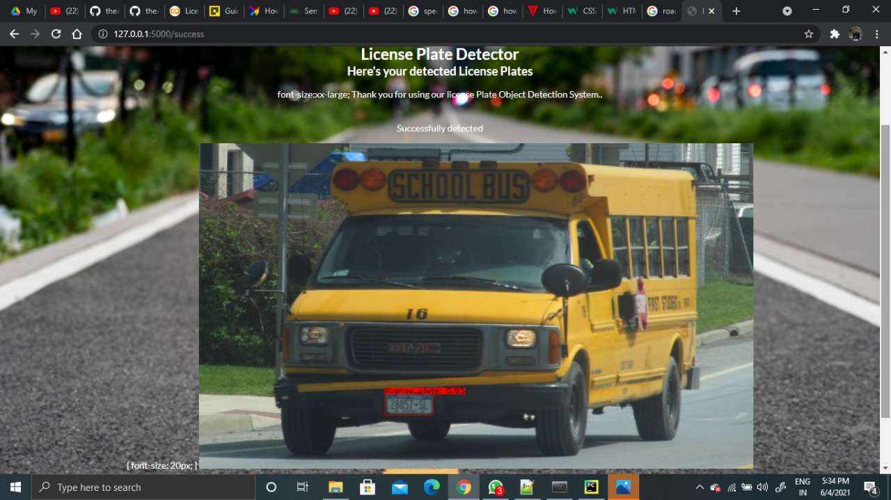

Deployment on Local

Slide 9
Summary
Finally, using Yolo, Darknet and TensorFlow, an end to end model is created which can detect license plate from any of the images and Videos provided. Future scope of the Project includes using the same as Webcam.

Slide 10


This Presentation is Prepared by
“Pranav Dange”

